Slide 1

GranaSat Batteries Tester
Names

Slide 2
Planification
Discharge C/10 → Charge C/10 → Vacuum → Discharge C/10

Slide 3
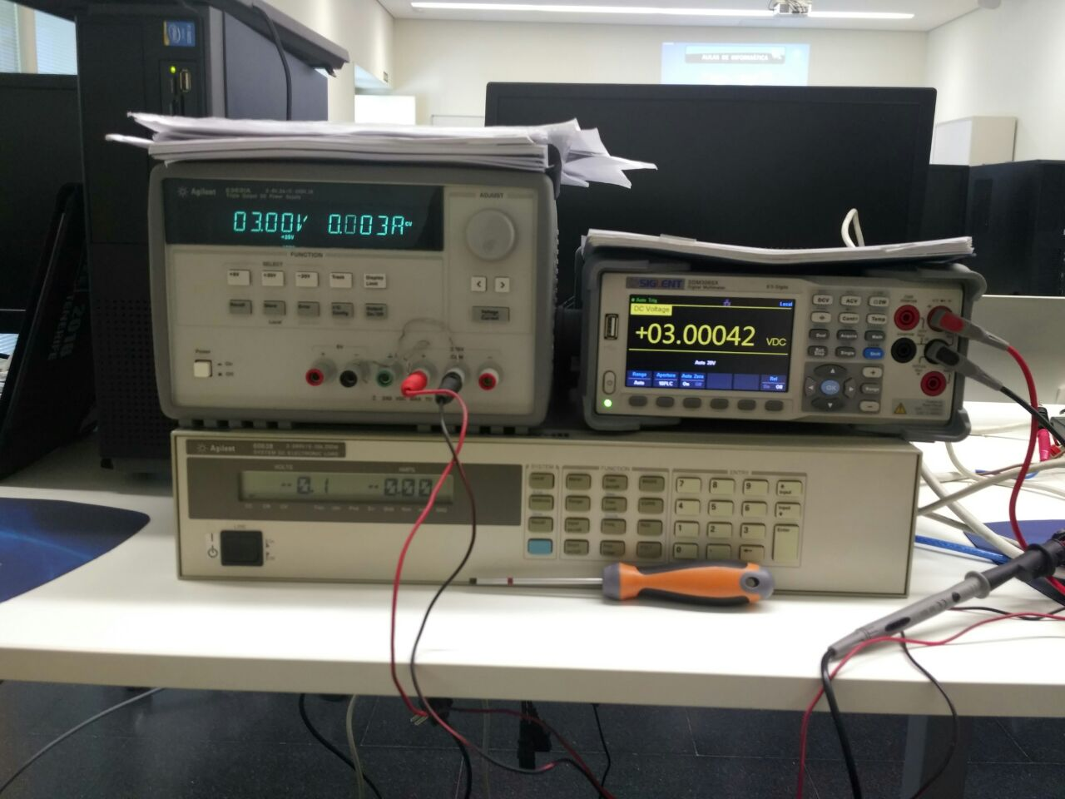
Equiptment Used
E3631A
DC-Supply
Multimeter SDM3065X
6063B
DC-Load

Slide 4
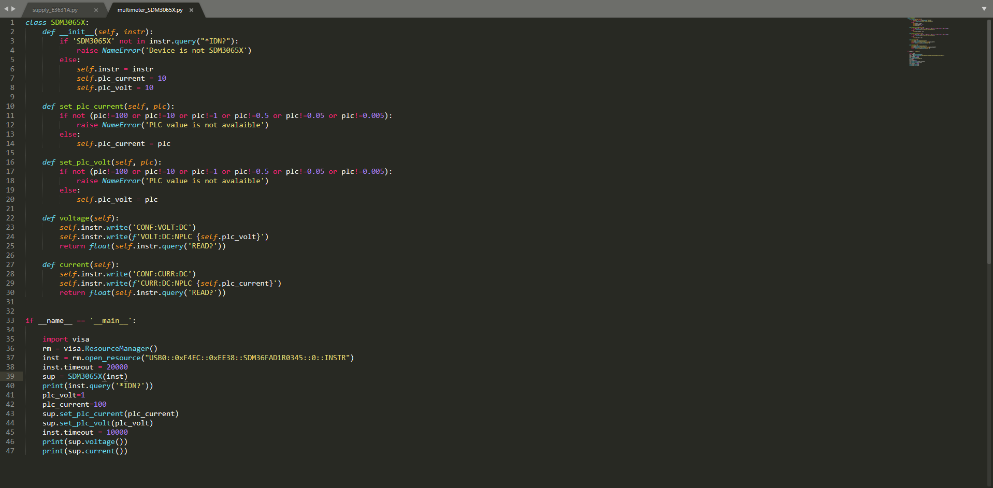
Instrument comprobation and value setting.
PLC value setting.
PLC value reading.
Program main.

Slide 5
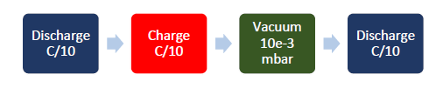
Test #1: High Vacuum Test
Test #2: Capacity and Internal Resistance vs Temperature
C → Measure of the rate at which a battery is discharged relative to its maximum capaity
Battery capacity versus temperature
Battery internal resistance versus temperature
Charging/ discharging voltage and current curves at different temperatures.
Battery size in charged and uncharged state
Battery capacity
Battery loss percentage after vacuum
Change in size after vacuum test
Test #3: High Vacuum Test

Slide 6
Test #1: High Vacuum Test
Measure the capacity loss after exposing the battery to high vacuum conditions.

Slide 7
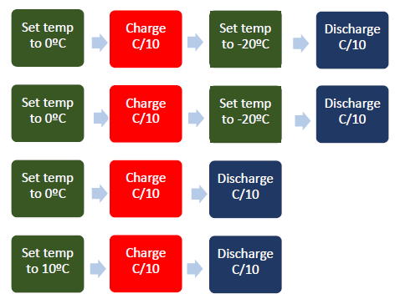
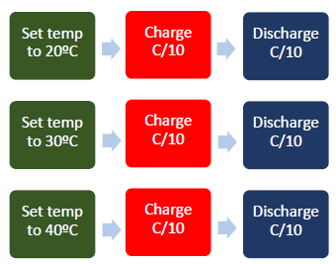
Test #2: Capacity and Internal Resistance vs Temperature
Measure the charge and discharge curve at several temperatures.

Slide 8
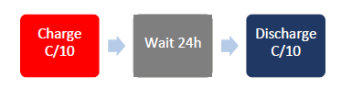
Test #3: Self-Discharge Test
Battery response after being left 24h on open circuit state.

Slide 9
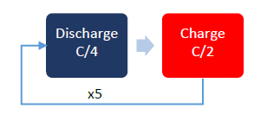
Test #4: LEO Cycling
Measure the capacity loss after charging and discharging the battery 5 times.

Slide 10
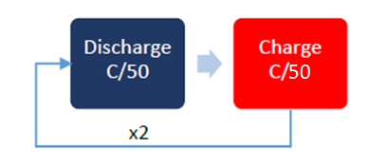
Test #5: EMF vs SOC
Obtain the relationship between the internal electromotive force and the state of charge.
Se carga y descarga dos veces lentamente para que la carga que caiga en la resistencia interna se pueda ignorar y obtener la relación entre el voltaje y el estado de la carga SOC. Para que la relación entre la EMF y el SOC se obtenga fácilmente

Slide 11
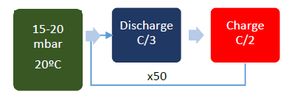
Test #6: Reduced pressure 30% DOD Cycling
Obtain the cell degradation for long periods when cycled under low pressure conditions.

Slide 12
Test #7: Reduced pressure 80% DOD Cycling
Obtain the cell degradation for long periods when cycled under low pressure conditions.

Slide 13


Graphic Interface made with Dash

Slide 14
Dash Code

Slide 15
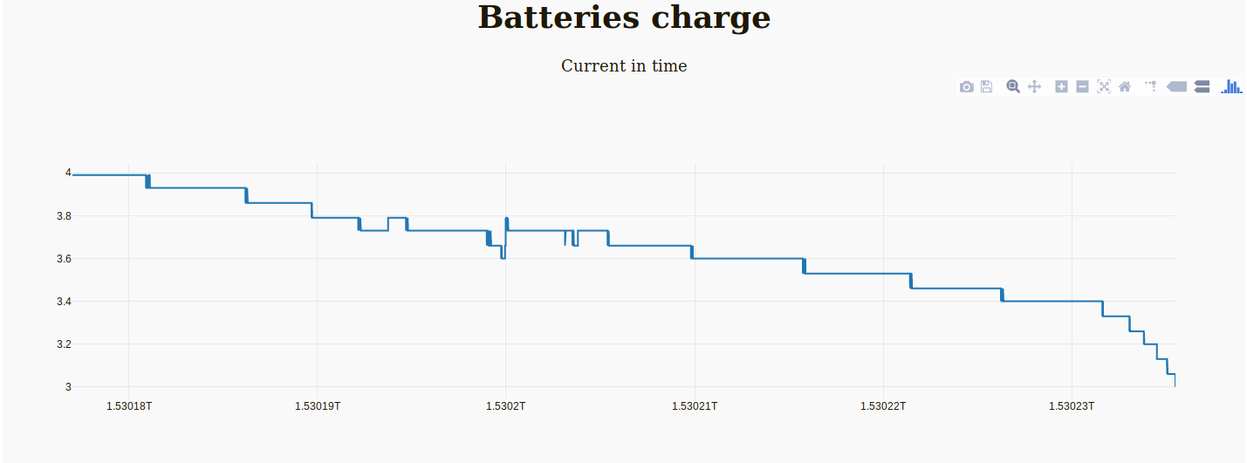
Starting Dash

Slide 16
